Slide 1

Neuro-Evolutional Don’t Touch the Spikes with Erlang
By: Nadav Hadad & Tamir Cohen
Advisors: Yehuda Ben-Shimol & David Leon
Course: Functional Programming in Concurrent and Distributed Systems, Ben Gurion University.

Slide 2

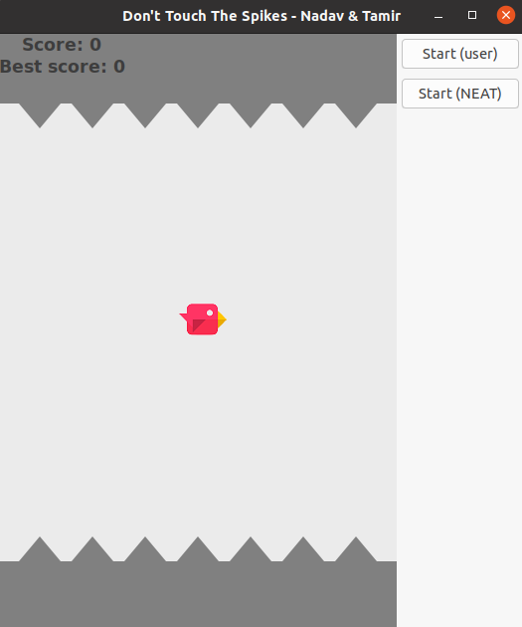
Main GUI

Slide 3

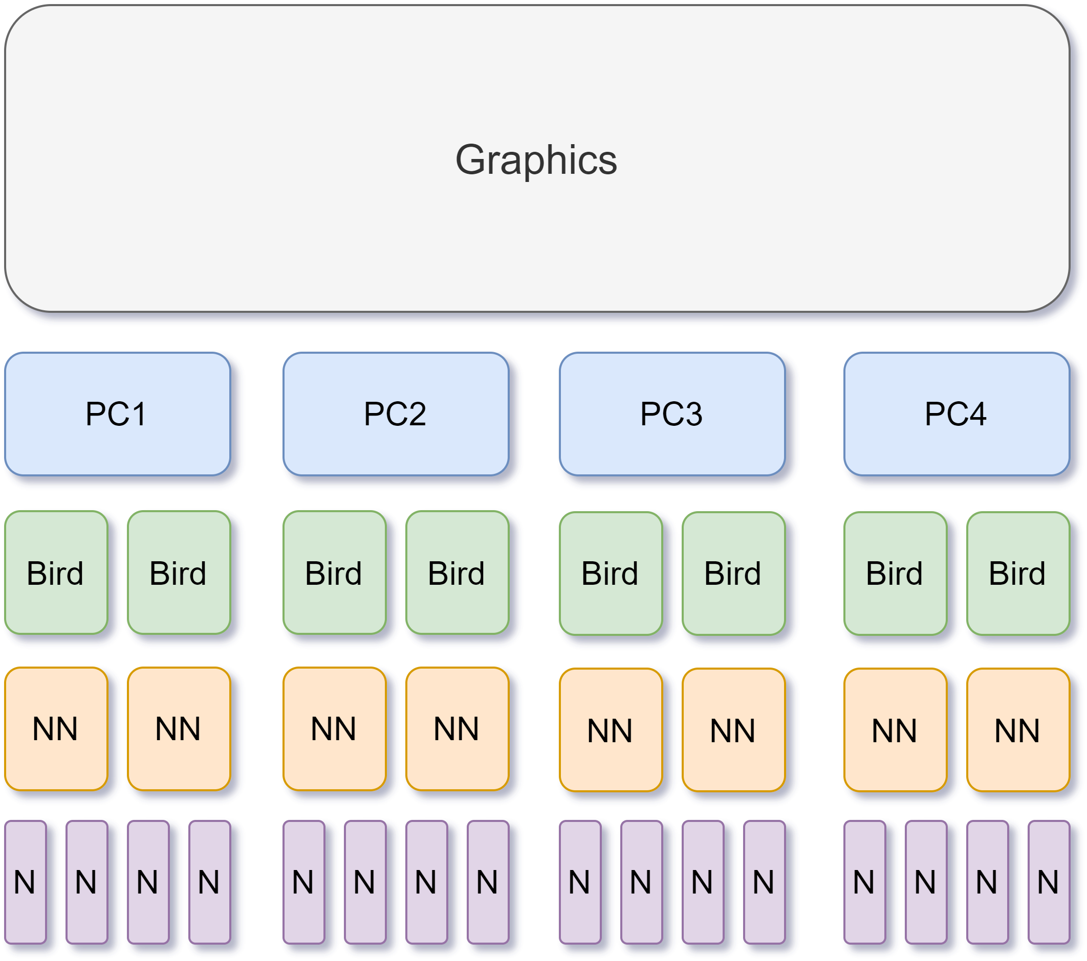
Project Layers & Design

Slide 4

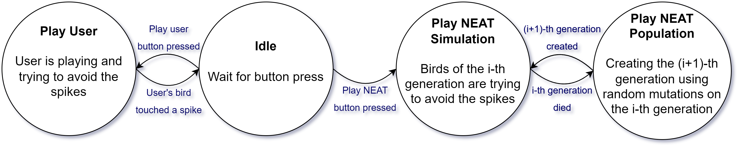
Graphics FSM

Slide 5
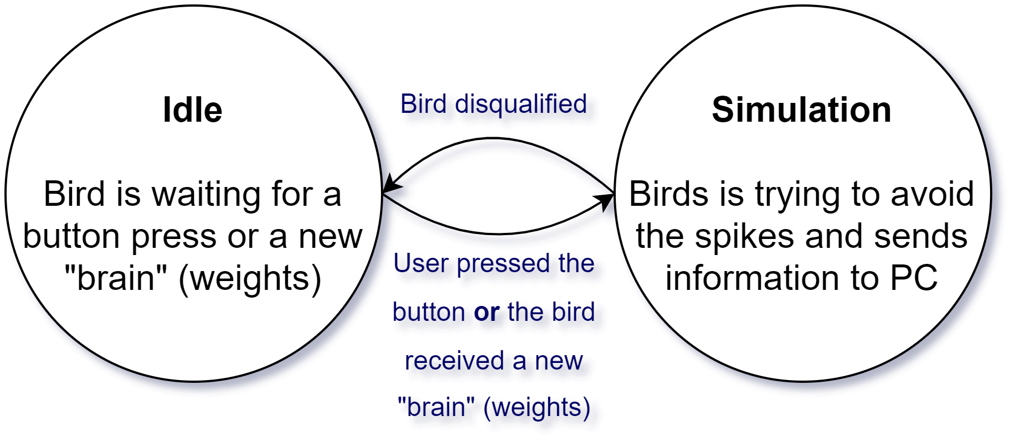
Bird FSM (User & NEAT)

Slide 6
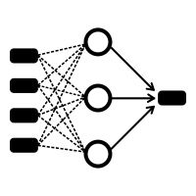
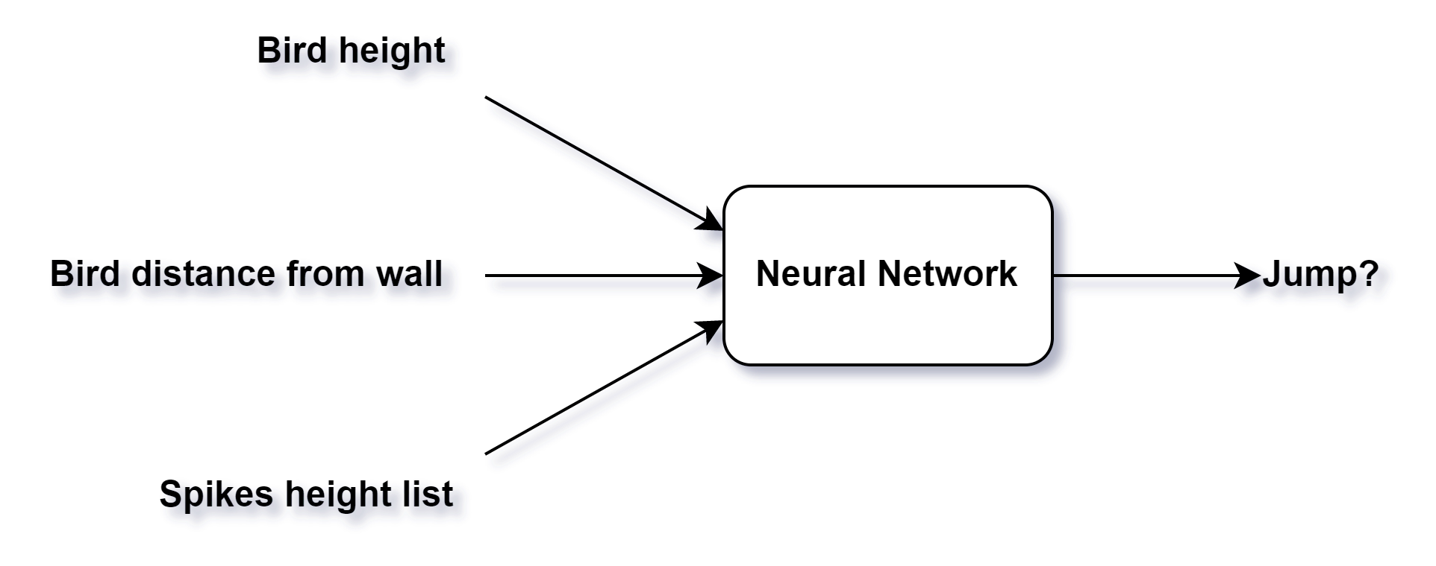
Neural Network
4 layers (11, 6, 6, 1)
tanh
20% survive

Slide 7

Node Down

Slide 8

Problems
- Switch bird’s “brain” (weight list).
- Run on computer’s lab.

Slide 9
Thank you for listening!

